Slide 1

Insurance Rate Setter
Aditya Mandhare
Ankit Gohil
Dharmendra Vaghela
Shivam Sachdev
Stuti Nanda

Slide 2

Problem?
Health Insurance Premiums
Stakeholder : Insurance firms
Convention?
Pooled Insurance Rates
High Risk
Attempt?
Competitive Rates for low risk individuals

Slide 3

Our Approach - Layers
Setting customized rates on basis of Customer:
Demographic profile - Location & Age
Social Network Profiles - Facebook & Twitter
Notes:
-insurace heath care domain
-rate setter

Slide 4

Data Collection
Census, Insurance Rates data, Location mapping data
Facebook, twitter
Notes:
Cms, county health ranking.com,

Slide 5

Challenges
Base Rates - Issuer Variability/Subsidies
Data privacy/permissions: Facebook

Slide 6

Implementation

Slide 7

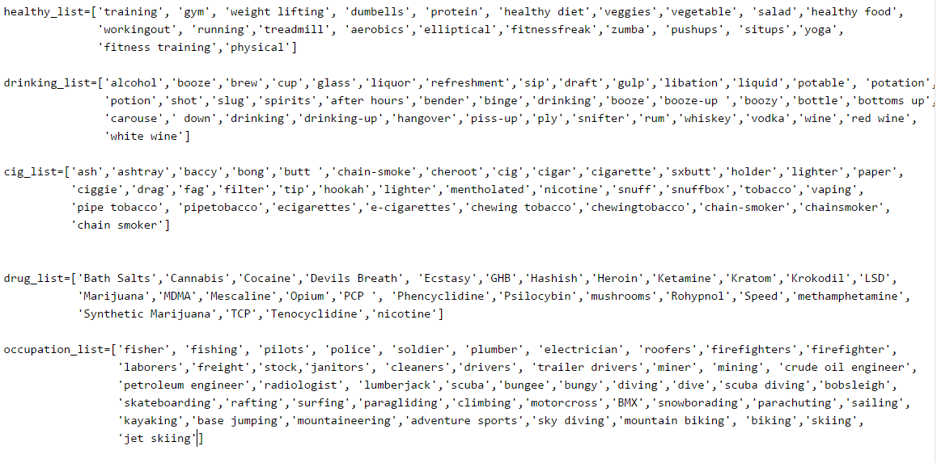
Dictionaries

Slide 8

METHOD - 1
For tweets and facebook posts
Counting the number of occurrences against dictionaries.

Slide 9

But..
“I love the smell of smoke” is same as “I hate when people smoke”
Sarcasm - “Yeah sure, I love smoking!”
Flawed approach: Specificity & Context

Slide 10

METHOD -2
Watson API calls - Alchemy Language processing
API calls not enough: had to take relevance into account (e.g. nouns too have relevance and +/- sentiment)

Slide 11

NLP
Keywords | Relevance | Sentiment
5 Dictionaries
Smoking
Drinking
Drugs
Occupation/Lifestyle
Healthy
Check relevance against dictionaries
Take most relevant keywords for each dictionary

Slide 12

Calculation Metrics
Base Rate - Healthy Profile
Adding Penalties
Penalty Phase-I: Penalty Phase-II:
Smoking: 10 Smoking: 0.7
Drinking: 4 Drinking: 0.5
Occupation: 3 Occupation: 0.34
Drugs: 8 Drugs: 0.62
Weights
Coefficients

Slide 13

BIAS
High income groups have risky lifestyles
Gender Neutral (on the lines of Obamacare)
Issuer variability has been discarded.

Slide 14
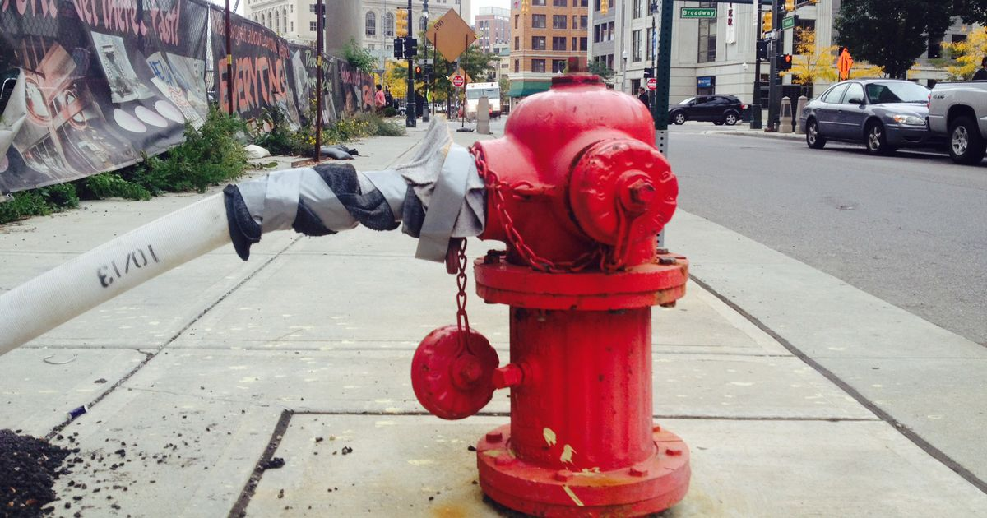
Fixable? Eh..
Empty facebook / twitter profiles - Handled
Neutralization effect : unhealthy and healthy - Handled
Fake profiles with fake data

Slide 15
Demo

Slide 16

Wiser than before!
Any third party app, once granted access via facebook has access to everything!!
EVERYTHING..!! (including ‘only me’ posts)

Slide 17

Future Scope
Base Rate Calculation - Learn thru
Subsidies
Issuers
Better User Profiling
Income based on decisions - dynamic wrt location
Penalties wrt Base Rate (Not static)
Plan increments according to location/base plan

Slide 18

Questions

